Slide 1
KC Flute Choir Redesign
By
Patrick McMahon
&
Brian Clopton

Slide 2
Agenda
Review of the current website
User Goals
Stakeholder Meeting Analysis
Conceptual Design
Evaluation Results
Theme and Template Content
New Site Demo
Before and After
Q & A
Site Handoff

Slide 3
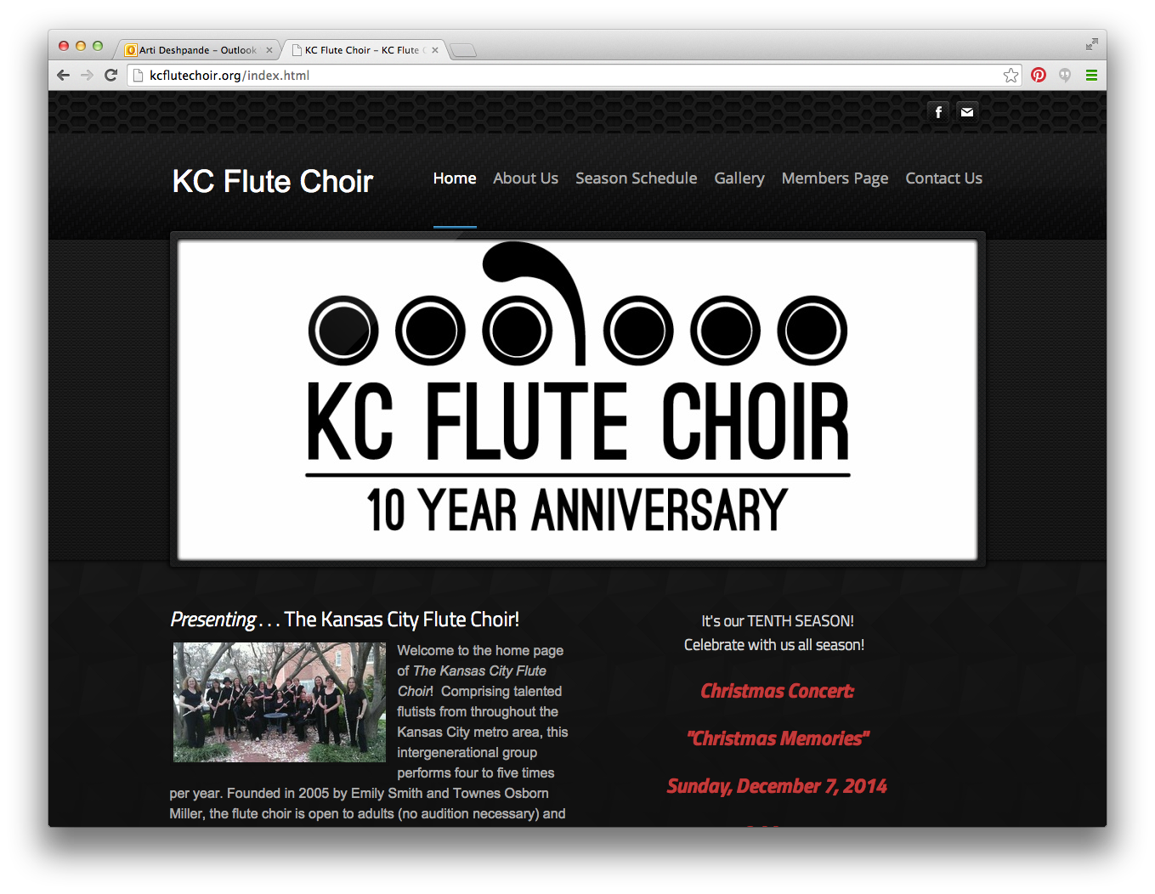
Current Site Evaluation
Multiple colors of font on a dark background make it difficult for the user to read and follow along. (1,4,8)
The site map at the bottom of page doesn’t align with the navigation at the top. (1,2,4,)
The main logo is static and doesn’t link to any content and takes up main portion of screen above the fold. (2,8)
Music sheet page has a list of images with links to fingering sheets, but it is unclear to the user which photo goes with which link. (2,4,8)
The schedule page is repetitive with “Fall Reunion” listed twice next to each other, creating confusion for the user on which column to look at. (2,8)
Within the content provided, the needed information for enrollment is in paragraph format, It could be in bullet format for easier readability. (2,8)
The contact page should be more focused on how to physically contact KC Flute Choir via email, map, telephone, social media and by other means. (2)

Slide 4

User Research
Typically we would reach out to your audience and receive feedback from them on the site.
We would ask questions about things they liked and disliked and what features they would like to include on the redesign.
To supplement this we spoke with the flute choir board to get their thoughts on the the current site.

Slide 5
Stakeholder Research
      User
Ability to make donations.
View KC Flute Choir documentation.
Organized and viewable Schedule.
Members
Sign up to be a member.
Pay semester dues.
View flute music sheets.

Slide 8
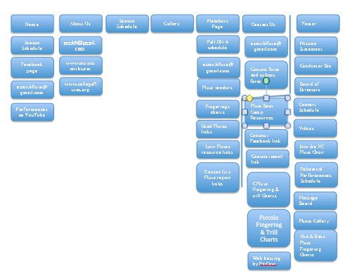
sITE mAP

Slide 9
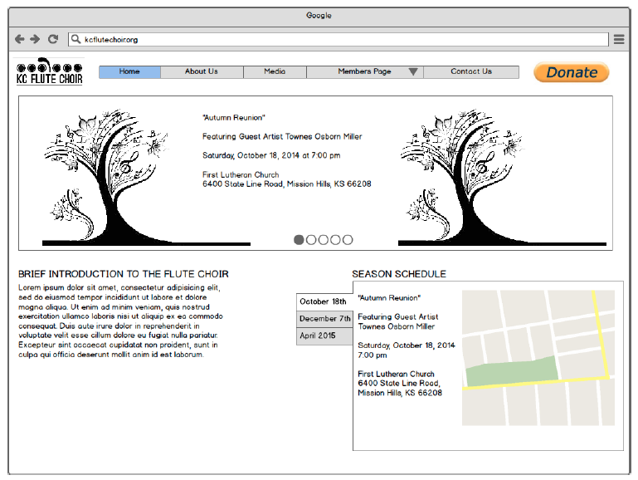
Wireframe – mAIN pAGE

Slide 10
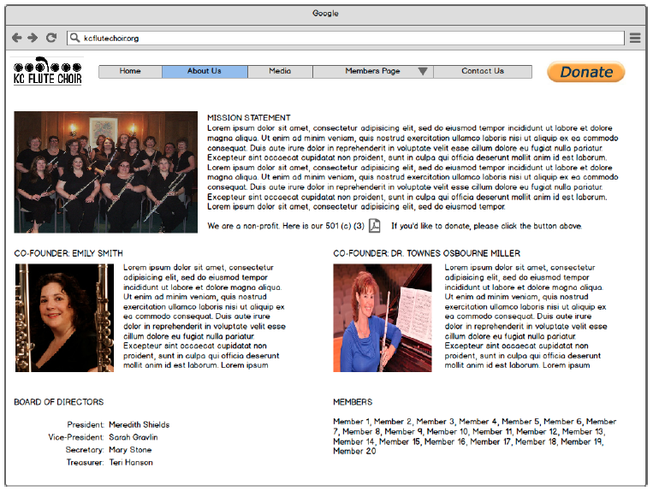
Wireframe – About US

Slide 11
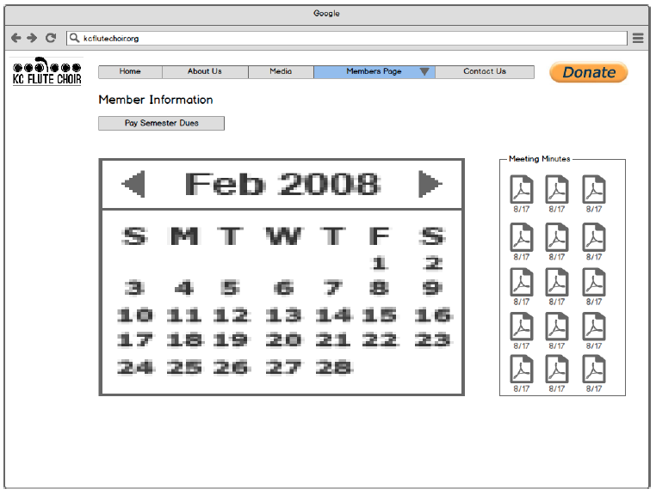
Wireframe – members pAGE

Slide 12
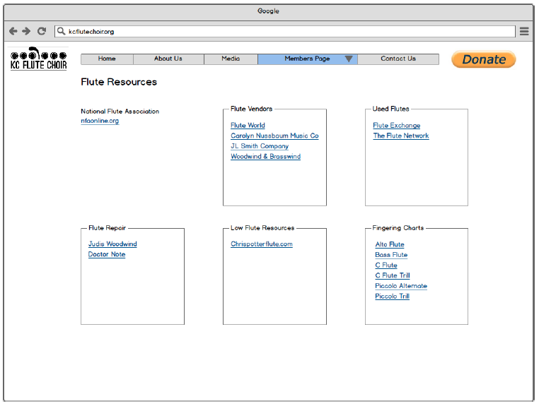
WIREFRAME – Flute Resources

Slide 13
USER VALIDATION

Slide 14
uSER vALIDATION

Slide 15
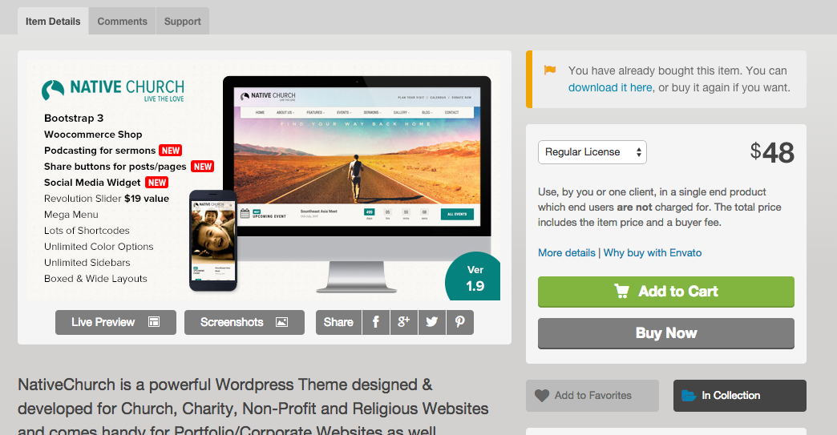
wORDPRESS Theme Selection
The Native Church theme
matched all the criteria
that we were looking for to
develop a fully functional site
with integrated support.
Built in donation feature
Auto-Responsive
Schedule and Rehearsal feature
& Documentation hosting

Slide 16

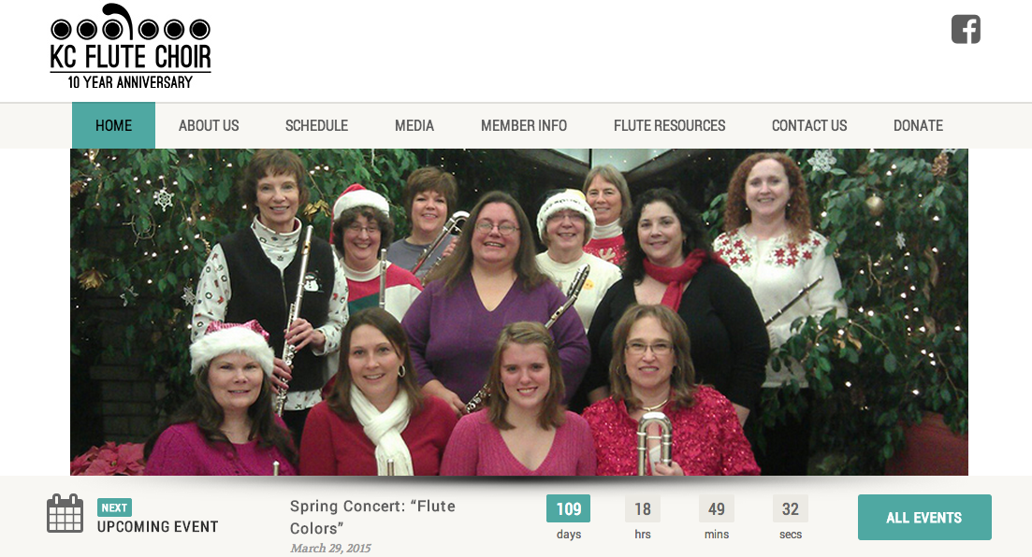
Before & aFTER

Slide 17
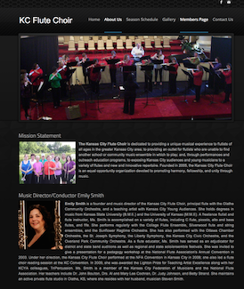
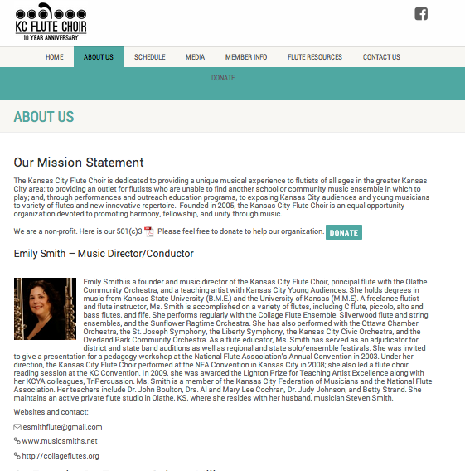
Before & AFTER

Slide 18
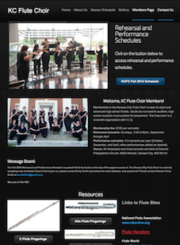
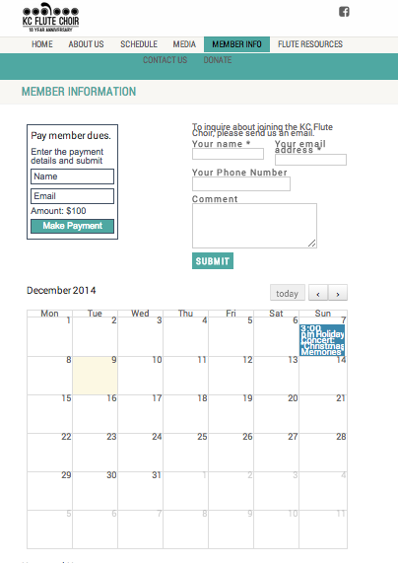
bEFORE & aFTER

Slide 19
Q & A
Any questions, comments or suggestions?

