Slide 1
Redesigning
Stone Pillar Vineyard & Winery
By Brian Clopton
Notes:
This presentation demonstrates the new capabilities of PowerPoint and it is best viewed in Slide Show. These slides are designed to give you great ideas for the presentations you’ll create in PowerPoint 2011!
For more sample templates, click the File menu, and then click New From Template. Under Templates, click Presentations.

Slide 2
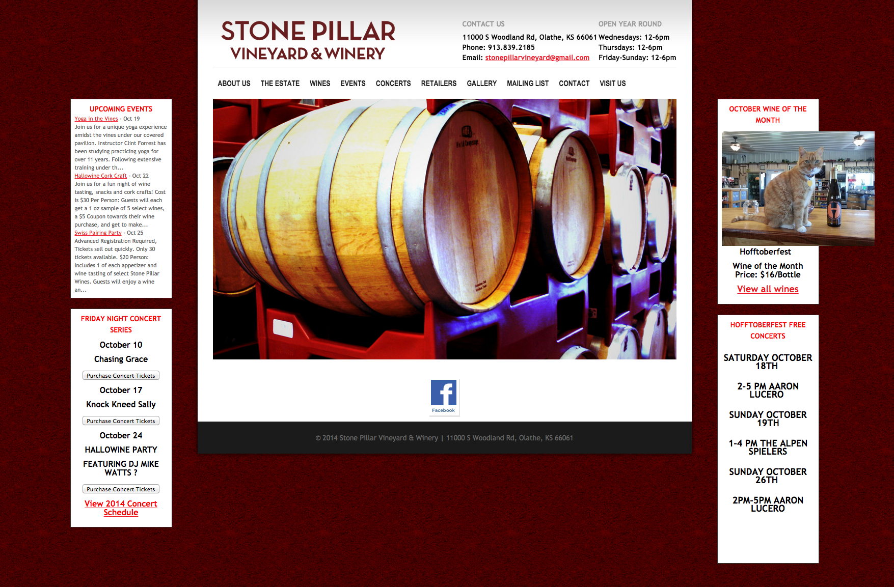
Notes:
-How the site looks currently

Slide 3
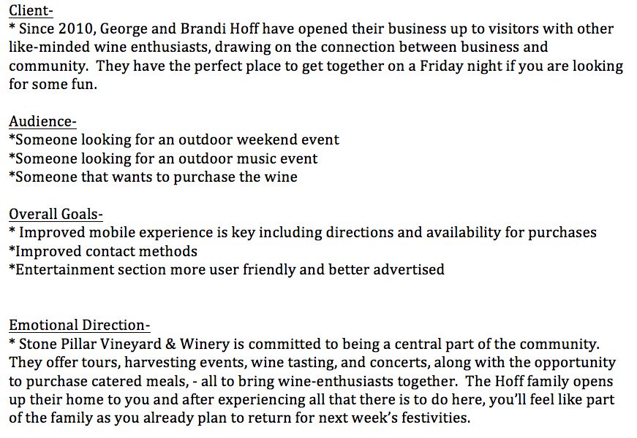
Synopsis:
Notes:
-Synopsis

Slide 4
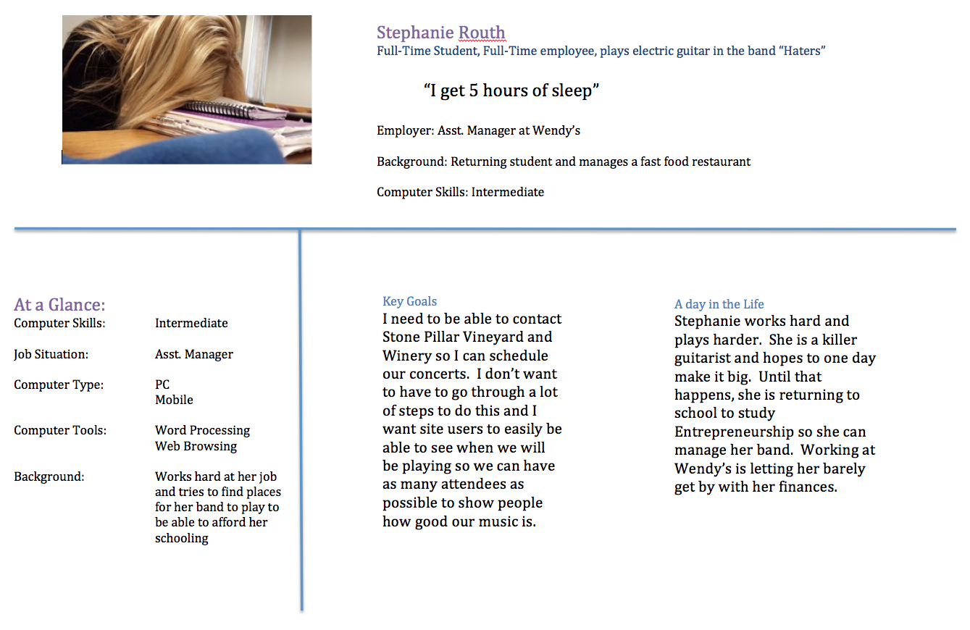
Notes:
Persona

Slide 5
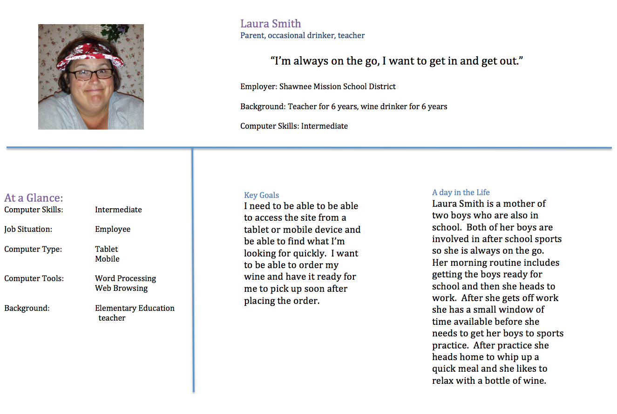

Slide 6
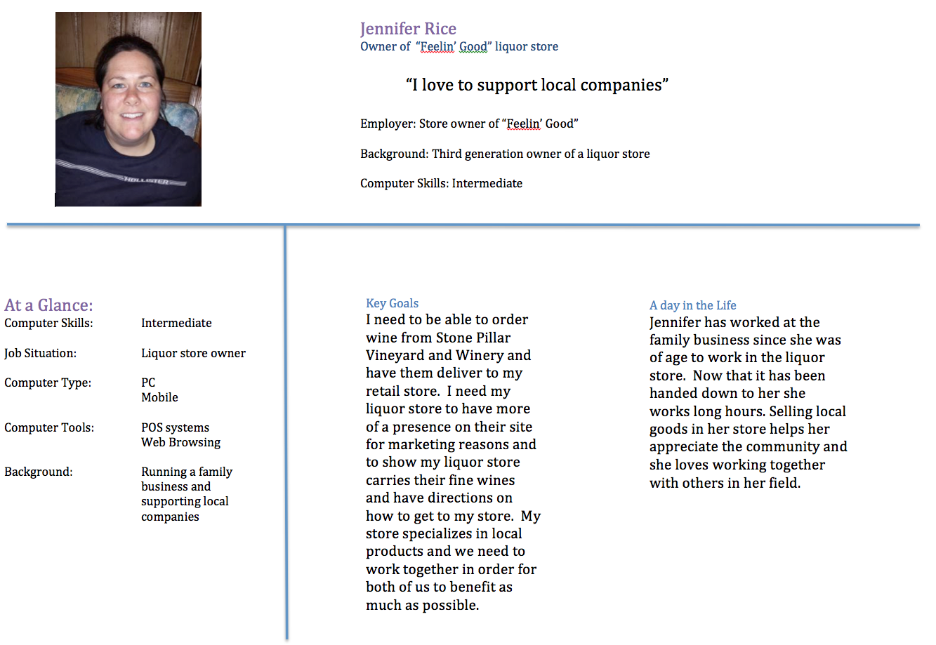

Slide 7
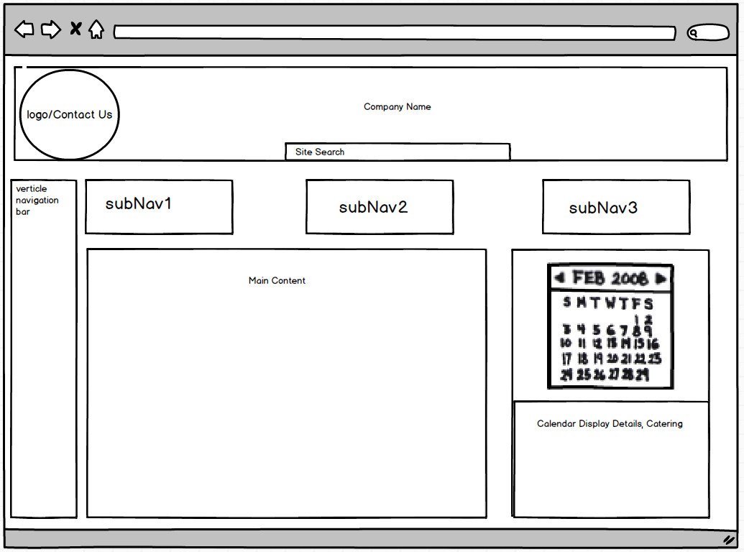
b
purchase
Notes:
Desktop/Tablet Landscape Home View 16 column. 1 for vertical nav bar, 3 others at 5 columns each

Slide 8
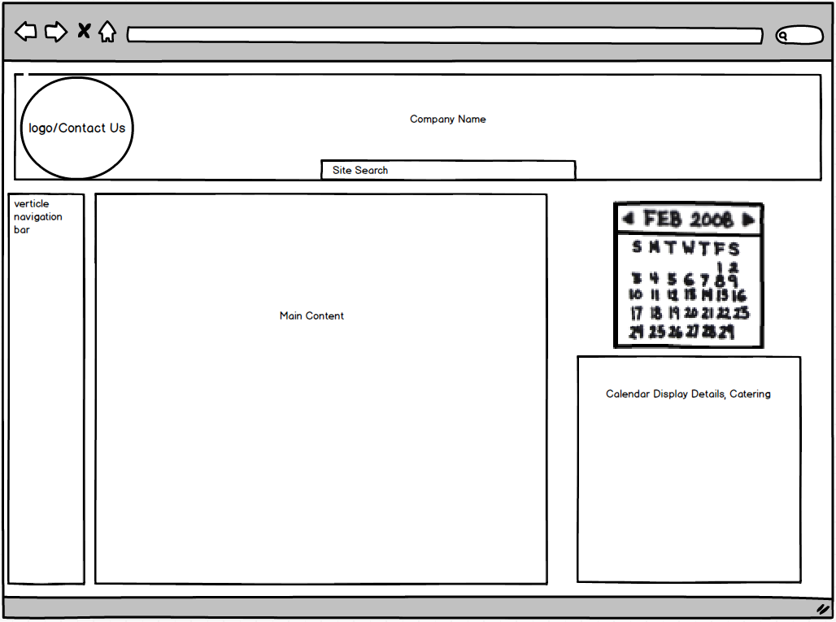
b
Purchase
Notes:
Desktop/Tablet Landscape Interior View- Into the third tab and into a subNav

Slide 9
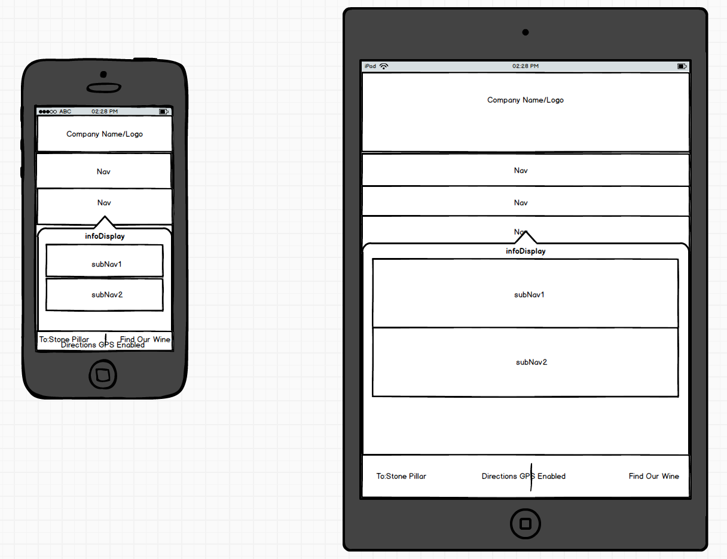

Notes:
Mobile and Table Portrait

Slide 10
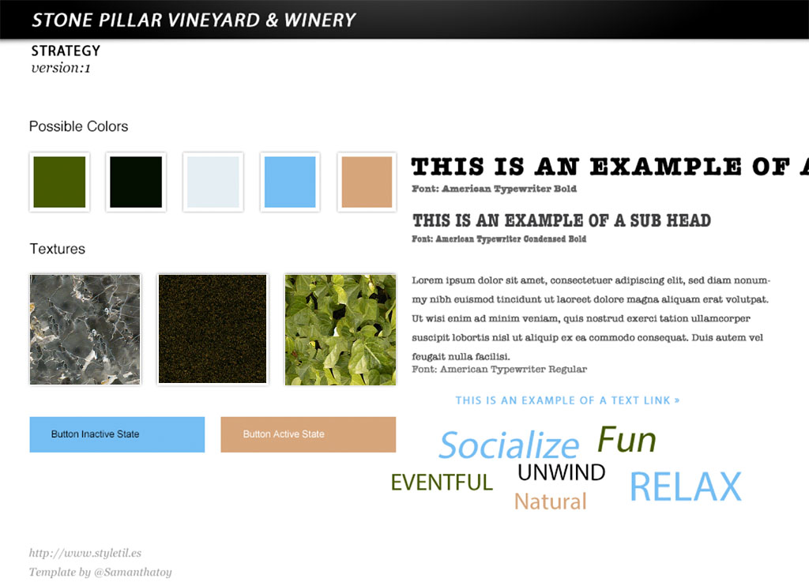

Slide 11
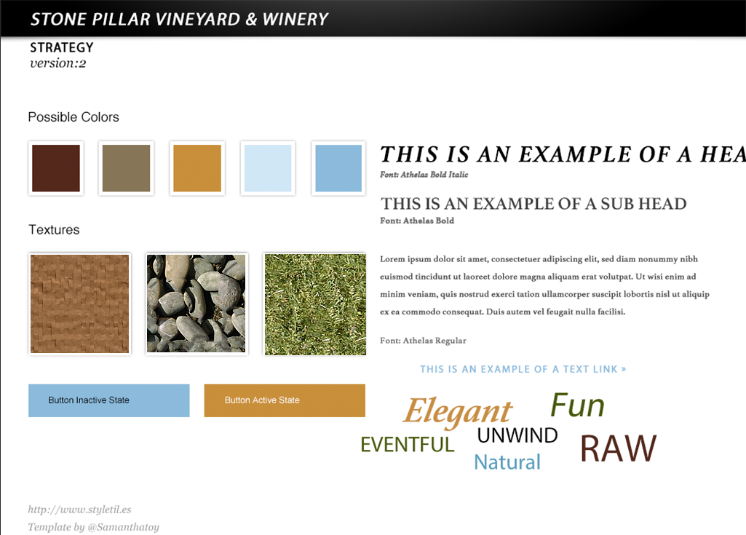

Slide 12
Thank you for your time

